Slide 1
Project Pitch 4 28th Feb
Alixander Roden S190762

Slide 2
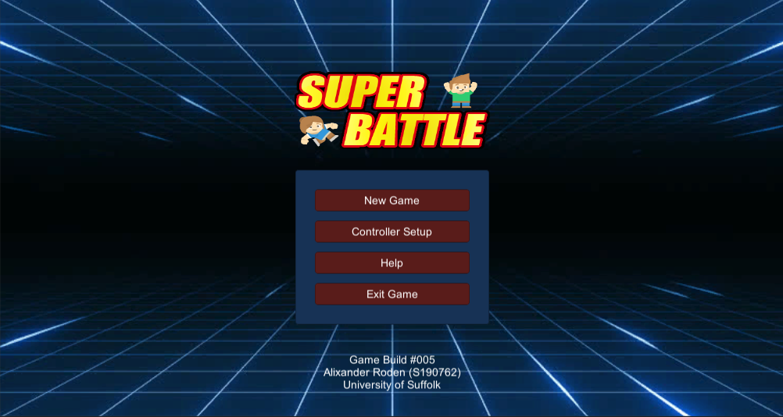
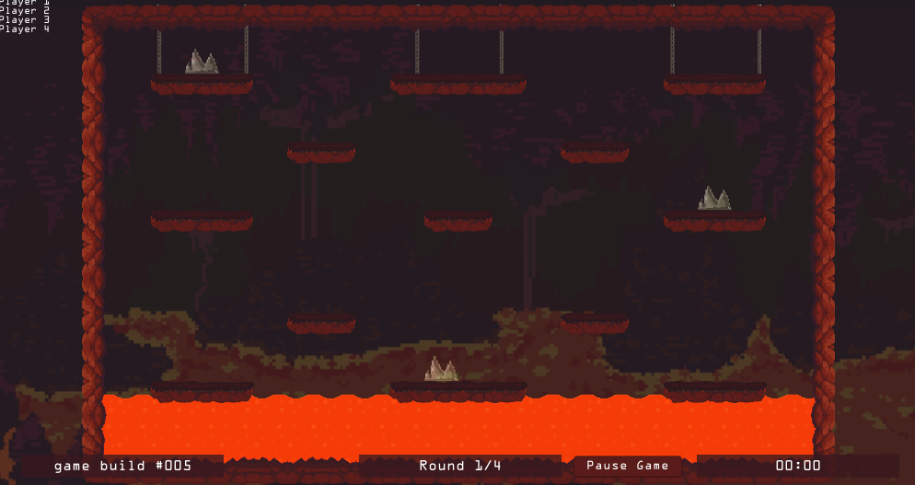
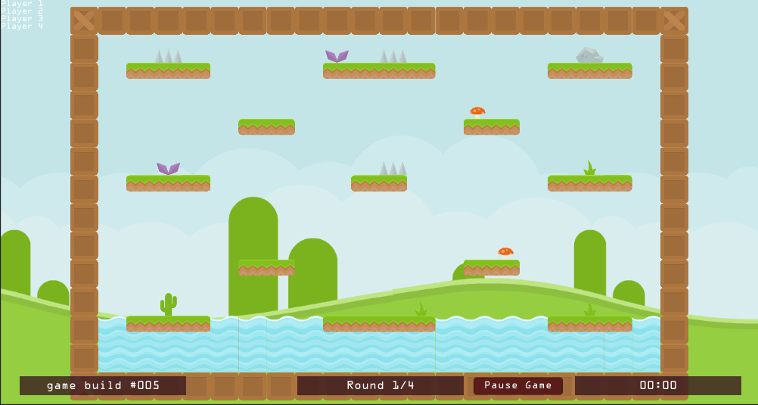
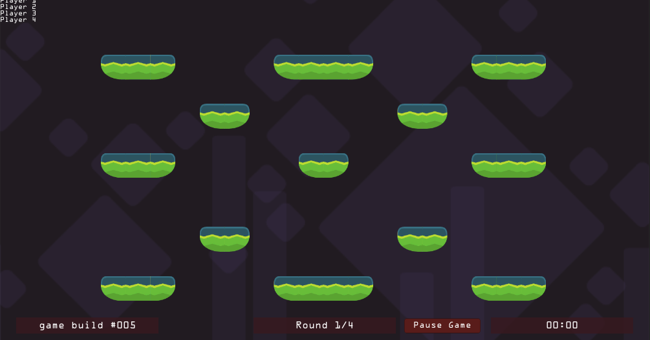
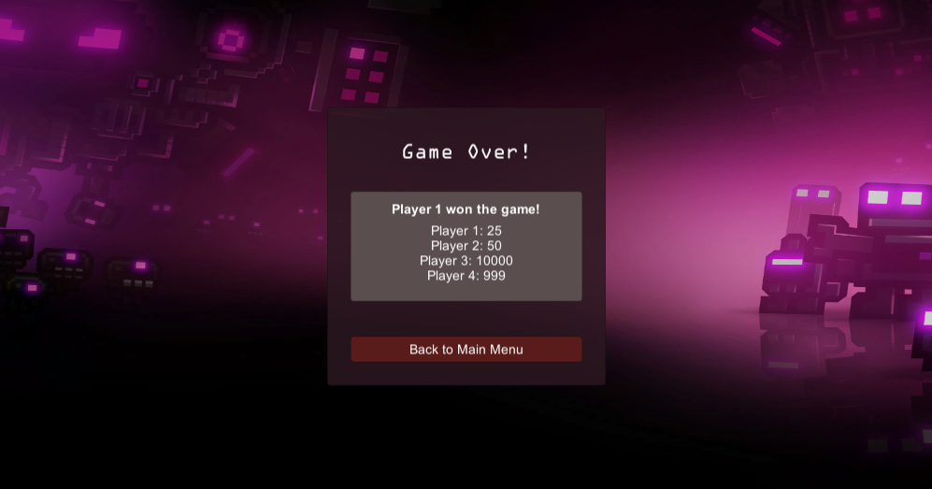
Game Flow
Main Menu
Round 1 – Size Modified
Round 2 – Speed Modified
Round 3 – Gravity Modified
Round 4 – All Modified
Game over – Score Screen

Slide 3
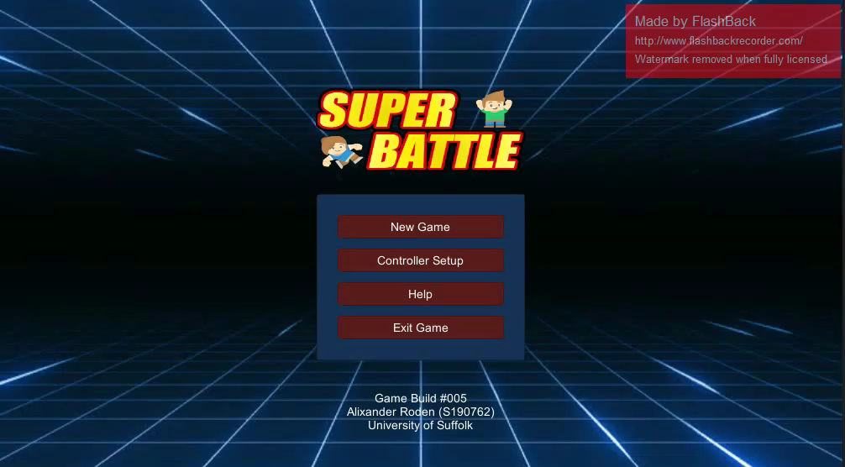
Game Video

Slide 4
Complete Features
Working score system, the score is kept track between scenes
Working item pickup/drop/taking items from other players
Basic UI, Main Menu/HUD/Game Over Screen/Help
4 controller support works, using a third party input manager asset
Game Flow, game goes between rounds when a player wins a round
Player controller/movement

Slide 5
Features to Include/Change
Top down view instead of platformer (Will require a change to the camera system, so that the camera follows all the players evenly)
The modifiers for each item, in top down view there will no longer be jumping so gravity isn’t useful
Testing with less players (2 or 3)
Levels need to be more open/varied
Puzzle mechanic? Certain areas of the level can only be accessed if you have a specific item
Sound effects/music
Code needs cleaning up / commented, at the moment there is a individual script for each item and each round (Round1ItemA.cs for example)

Slide 6
Timeline for Completion
Pitch 5 28th March
New levels should be implemented
Change of view system
Pitch 7 9th May
Fully complete game, with polished assets/sound effects/music/testing

